Slide 1
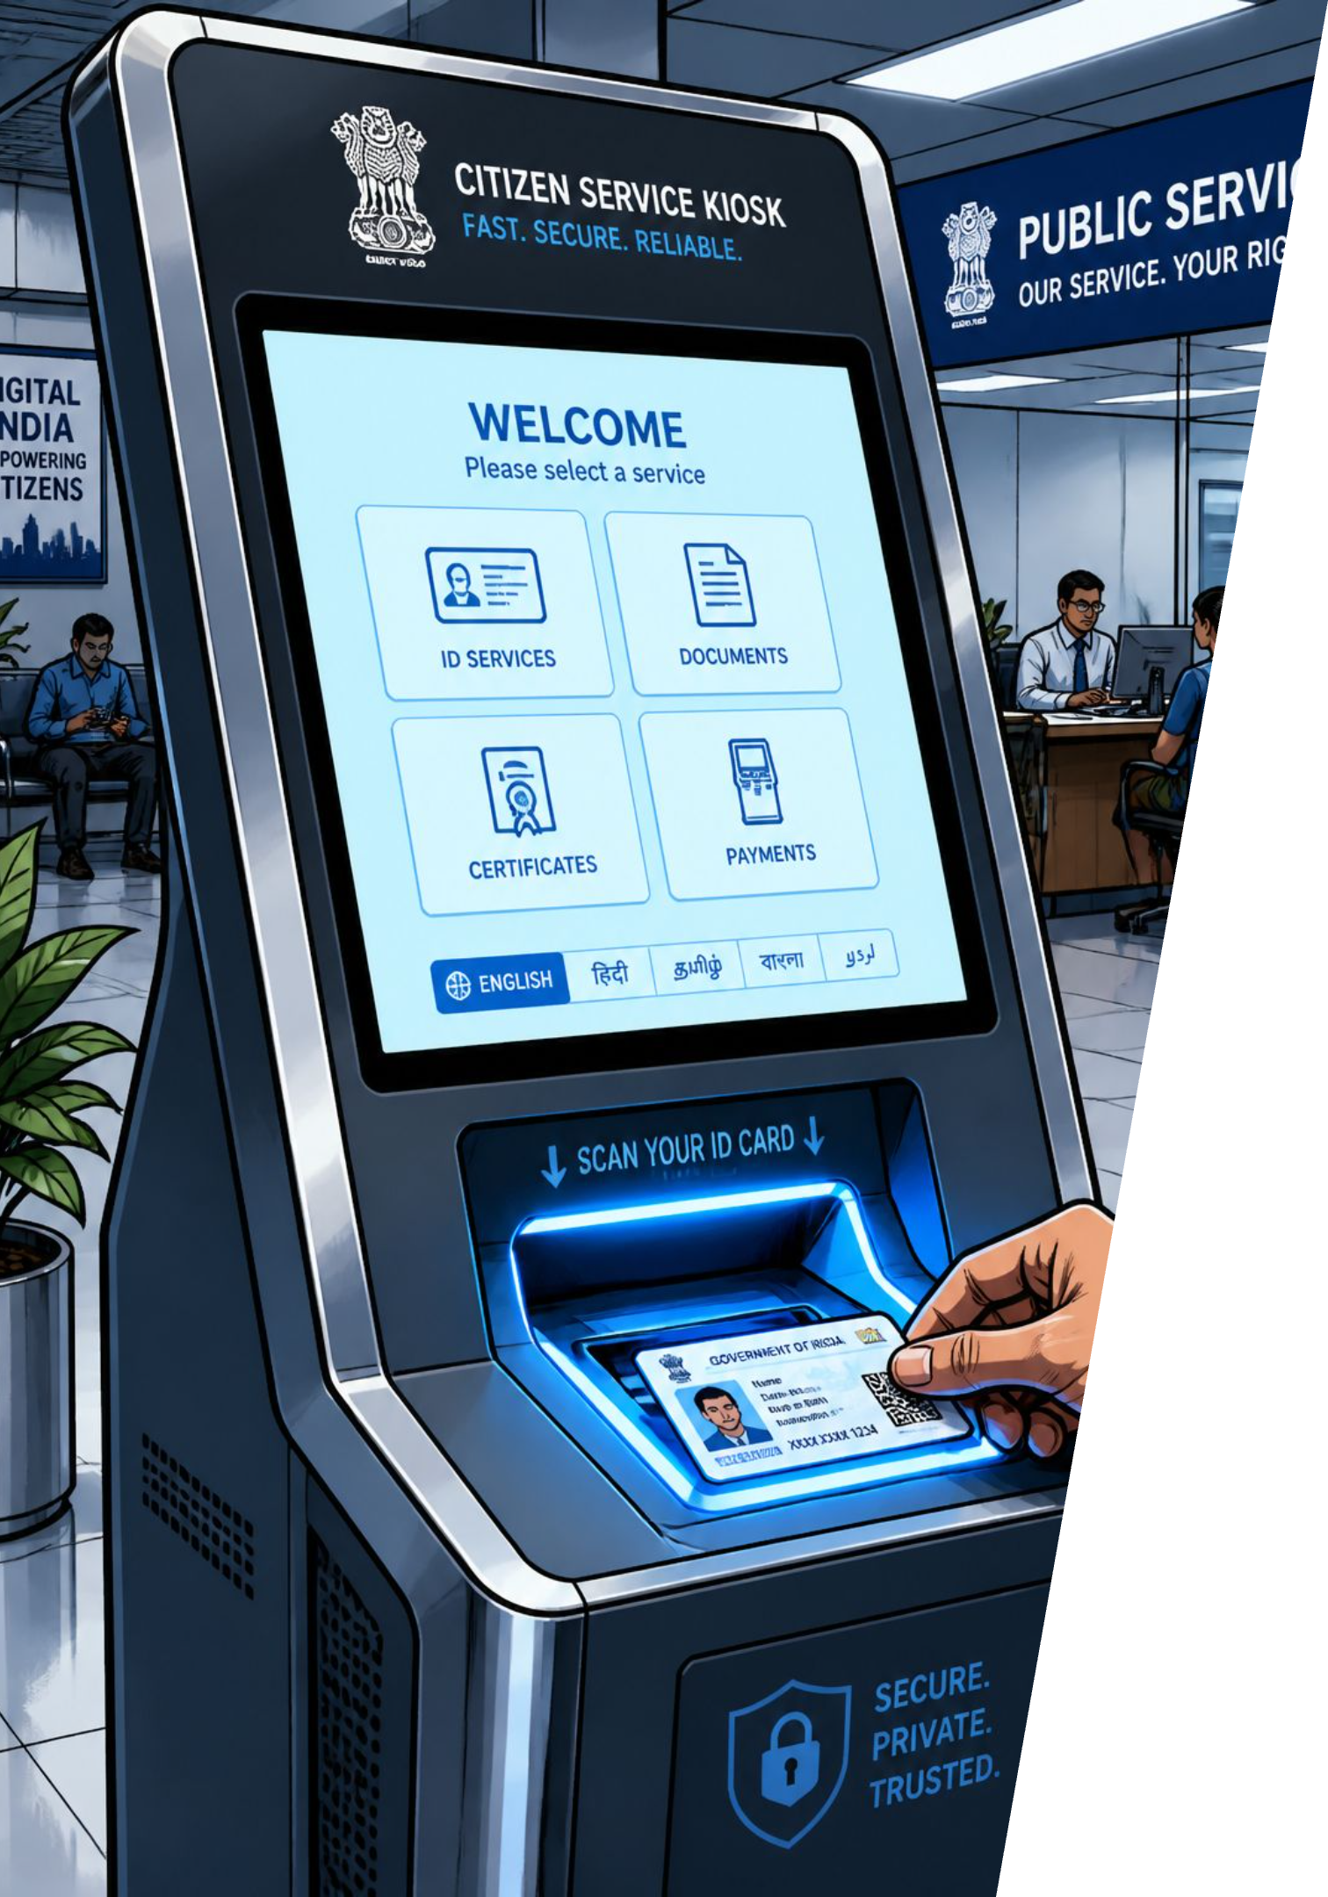
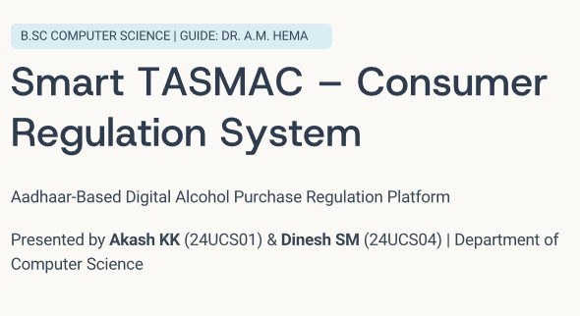
Smart TASMAC — Consumer Regulation System
Aadhaar-linked digital platform to regulate alcohol purchases — college final year project by Akash KK (B.Sc Computer Science). Academic Year 2025–2026. Guide: Faculty Name, Dept. of Computer Science.

Slide 2

Problem Statement
No Identity Verification
Underage & Unlimited Buying
Purchases occur without Aadhaar or reliable ID checks.
Minors can buy alcohol and consumers face no limits.
No Monitoring or Analytics
Lack of Transparency
No purchase history, doctor restrictions, family monitoring, or real-time government analytics.
Manual reporting and absence of digital audit reduce accountability.

Slide 3
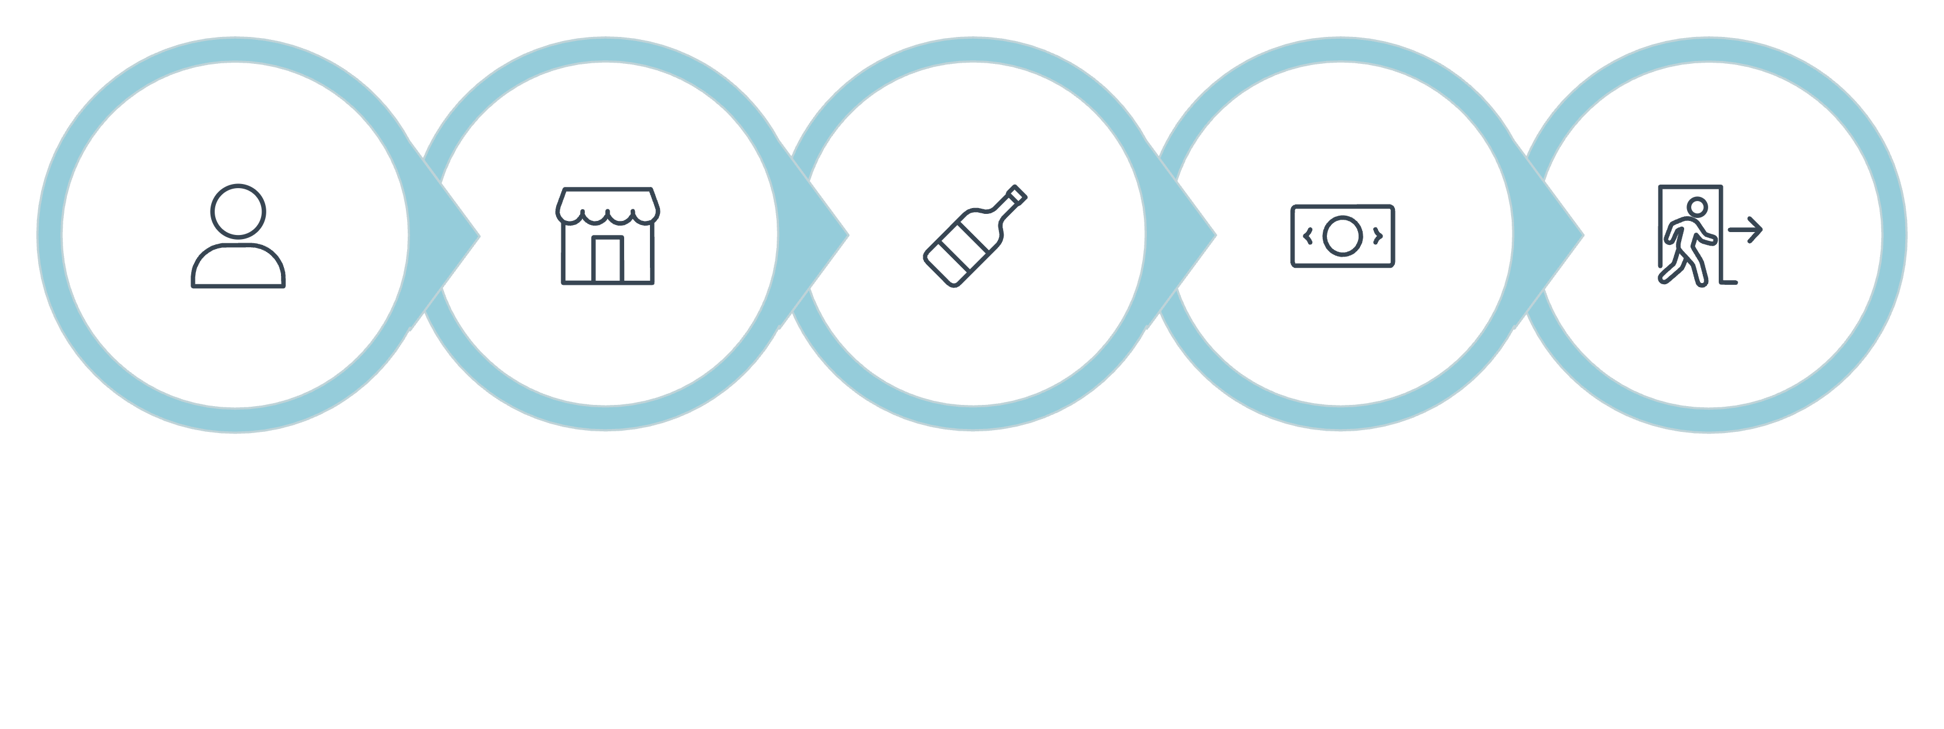
Existing System — Workflow
Cash Payment
Customer
Visit Shop
Buy Alcohol
Leave
The current TASMAC retail workflow lacks digital identity checks, audit trails, health monitoring, purchase limits, and government analytics.

Slide 4
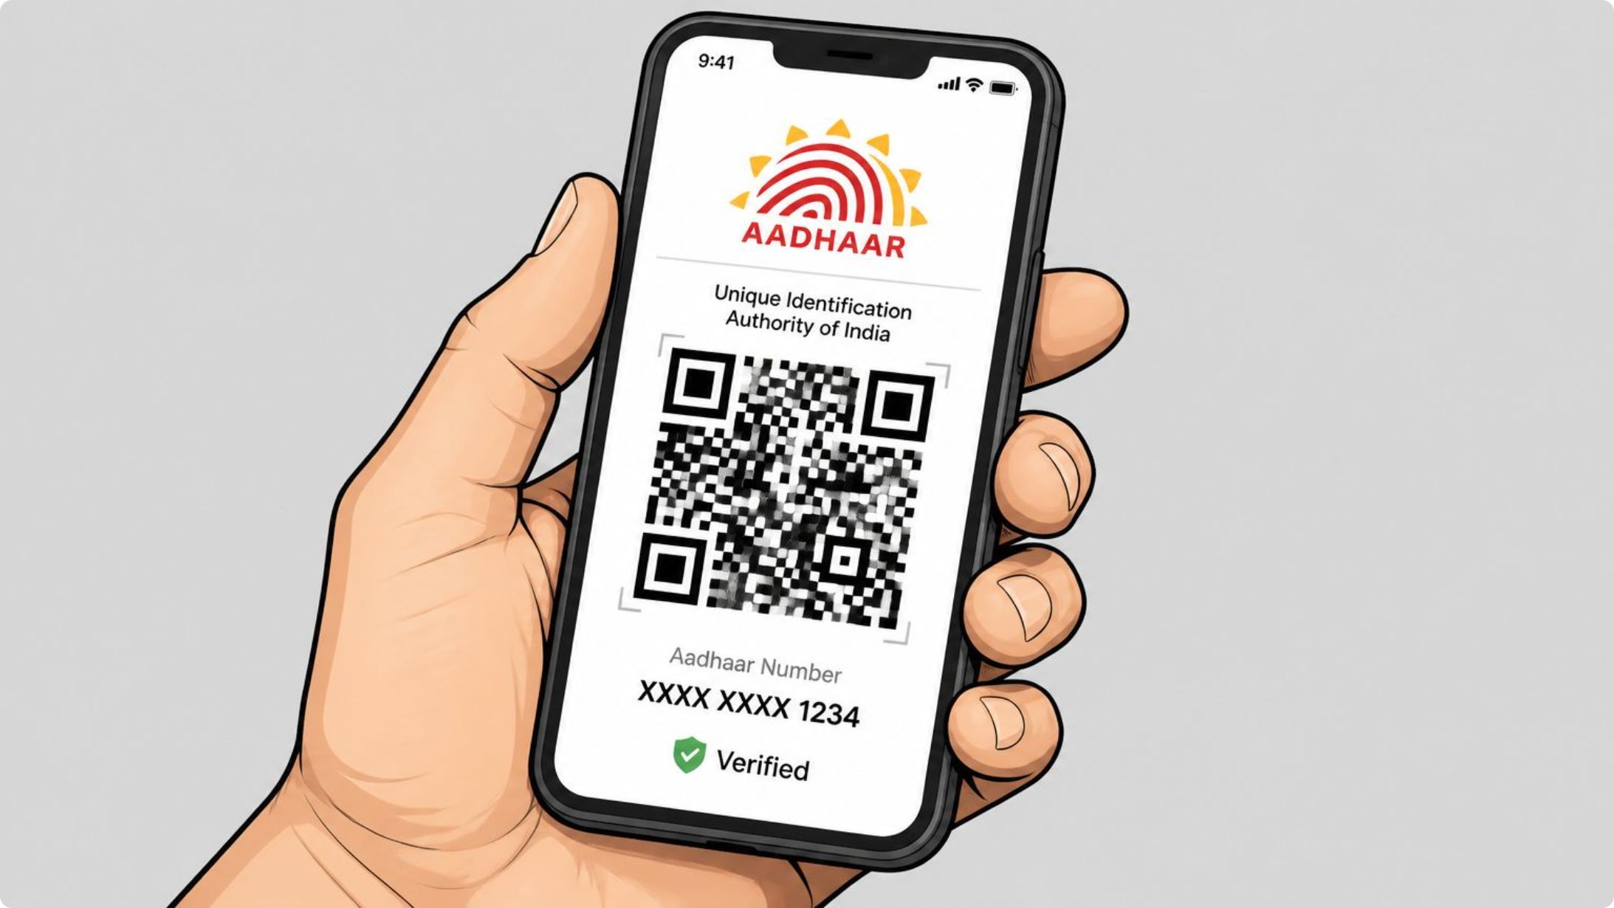
Proposed Solution Overview
Aadhaar Registration
Secure, verified consumer identities.
QR Code Identity
Quick in-shop verification.
Purchase Limits
Enforce consumption caps
per consumer.
Doctor Restrictions
Medical professionals can
restrict purchases.

Slide 5
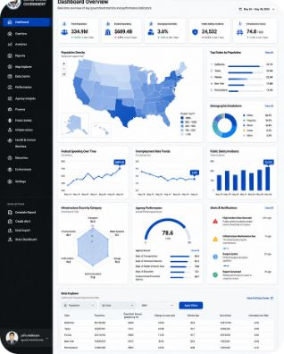
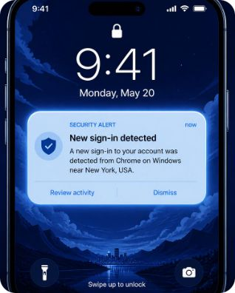

Features & Benefits
Government Dashboard
Notifications & Digital Audit
Caretaker Monitoring
Real-time analytics and reports for policy and enforcement.
Automated alerts and maintainable purchase history (PDF reports).
Family members can supervise and enable teetotaler mode.

Slide 6

Project Objectives
Prevent Underage Purchase
Identity verification blocks minors.
Regulate Consumption
Purchase limits and teetotaler options promote responsibility.
Support Healthcare
Doctors can restrict patients as needed.
Transparency & Reporting
Digital audit trails and government reports improve oversight.

Slide 7

Stack: React frontend, FastAPI backend, JWT for security, PostgreSQL storage, QR code generation, and PDF reporting for audits.
System Architecture
Government dashboard
Consumer
Regulatory interface
User on mobile device
PostgreSQL database
Technology Flow
React frontend
Interactive UI and QR
handling
Persistent storage
JWT authentication
FastAPI backend
API layer and business logic
Secure token-based auth

Slide 8
Core Modules
Consumer Module
Aadhaar registration, QR, purchase history, limits, notifications, PDF/health reports, teetotaler mode.
Government Admin Module
Shop Operator Module
Login, QR scan, verify eligibility, sell products,
sales history.
Dashboards, analytics, reports, policy enforcement tools.
Doctor & Caretaker Modules
Medical restrictions, family monitoring, support workflows.

Slide 9
Smart TASMAC Consumer Management System – Module List
Public Portal – Landing page, registration, role selection.
Consumer Module – Registration, dashboard, QR code, purchase limits, history, reports.
Shop Operator Module – Consumer verification, QR scanning, sales management.
Government Admin Module – Consumer, shop, doctor, reports, analytics, system management.
Doctor Module – Issue restrictions, monitor patients, analytics.
Caretaker Module – Monitor linked consumer, receive alerts, manage consent.
Authentication & Security Module – Login, JWT authentication, role-based access.
QR Management Module – QR generation, validation, scanning.
Notification Module – SMS, email, and in-app alerts.
Reports & Analytics Module – Sales, revenue, addiction trends, PDF reports.
Audit & Compliance Module – Activity logs and transaction auditing.
System Administration Module – User management, settings, backup, monitoring.

Slide 10
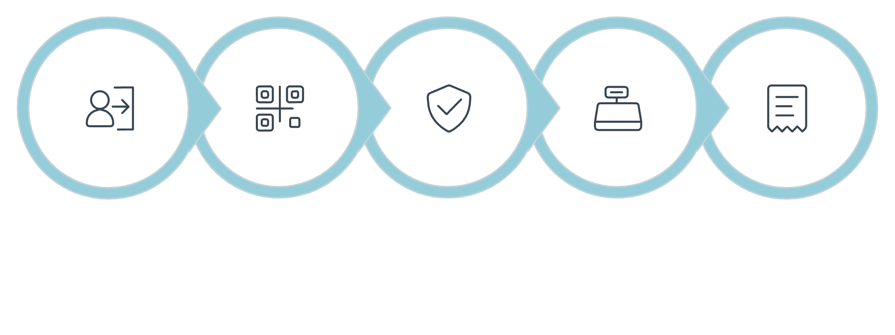

Shop & Doctor Workflows
Verify Eligibility
Record Transaction
Authenticate
Set Restriction
Enforce Block
Notify Caretaker
Login
Scan QR
Process Sale
Both workflows integrate with the central backend to enforce limits and update audit logs in real time.

Slide 11
Key Smart Features
Aadhaar Verification
QR Code Purchase
Daily Purchase Limit
Weekly Limit
Monthly Limit
Doctor Restriction
Caretaker Monitoring
Notifications
PDF Reports
Audit Trail
Smart TASMAC offers a comprehensive suite of features to ensure responsible alcohol regulation, from identity verification to detailed analytics and medical oversight.

Slide 12
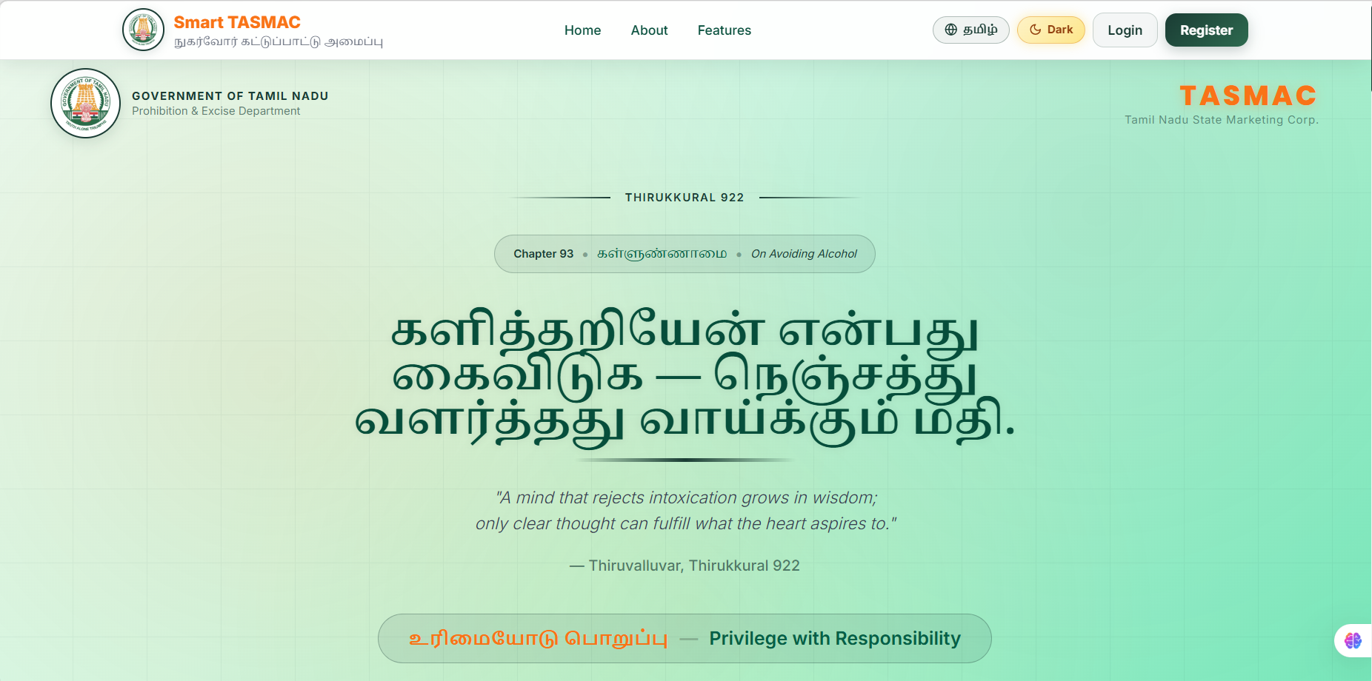
USER INTERFACE 1 : Landing portal for consumer
Public entry page for Smart TASMAC, offering system information, registration, and secure role-based login access.

Slide 13
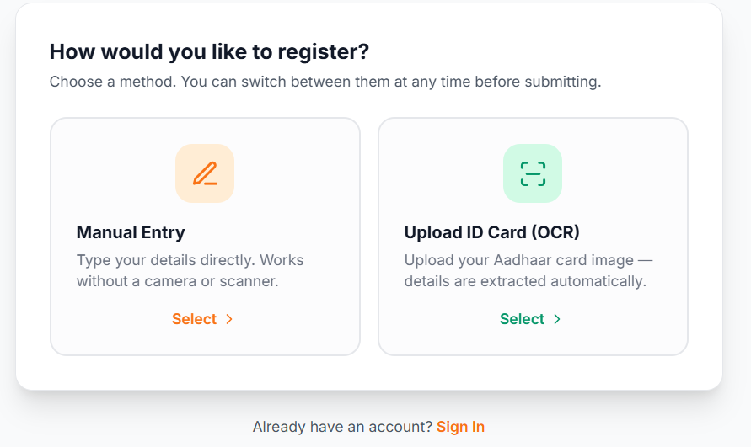
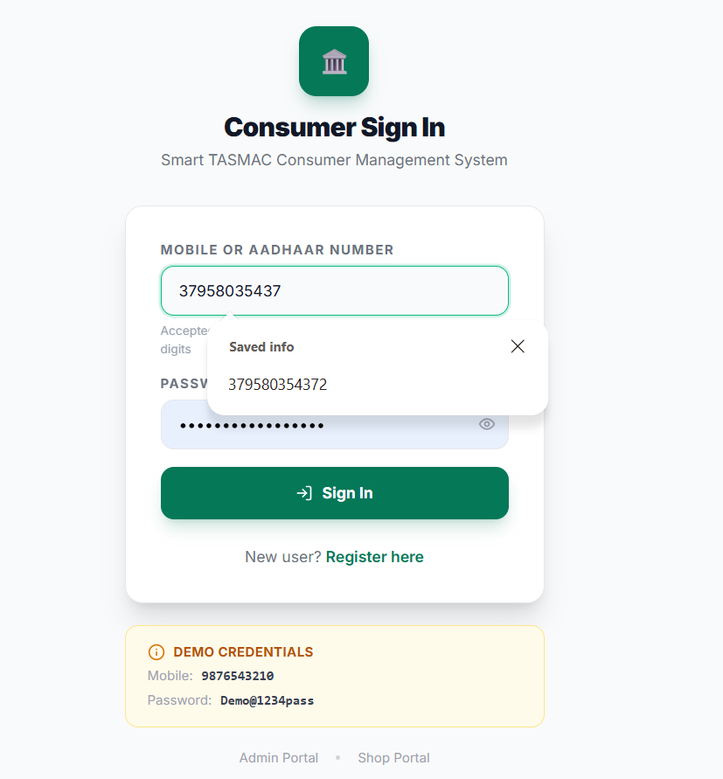
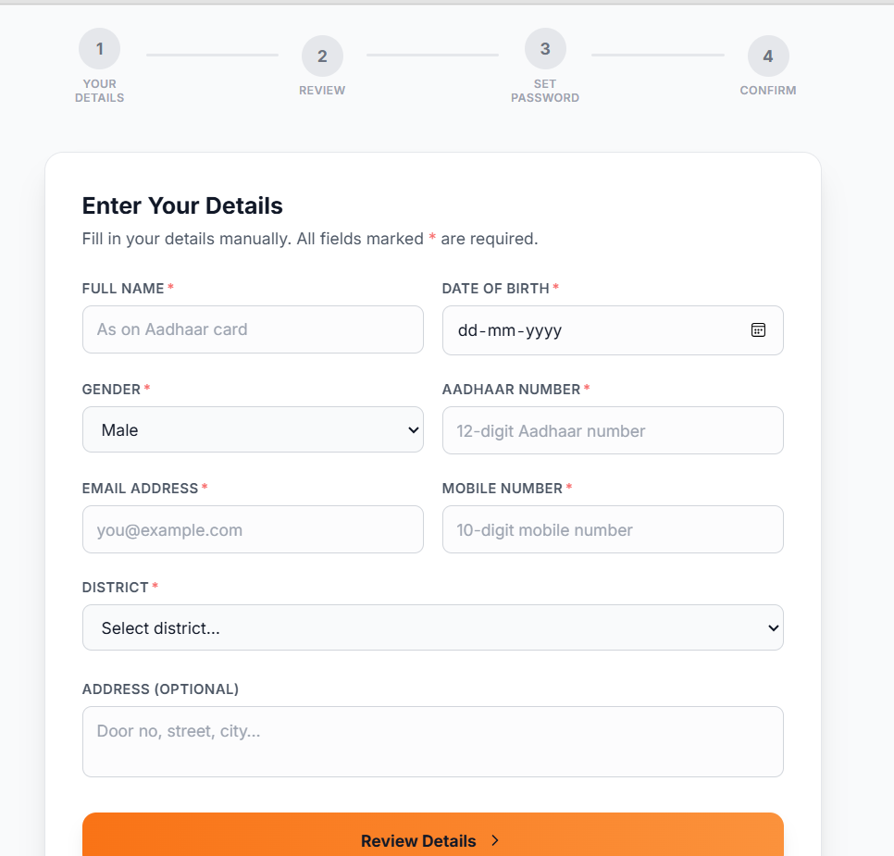
USER INTERFACE 2 : Registration Portal for Consumer

Slide 14
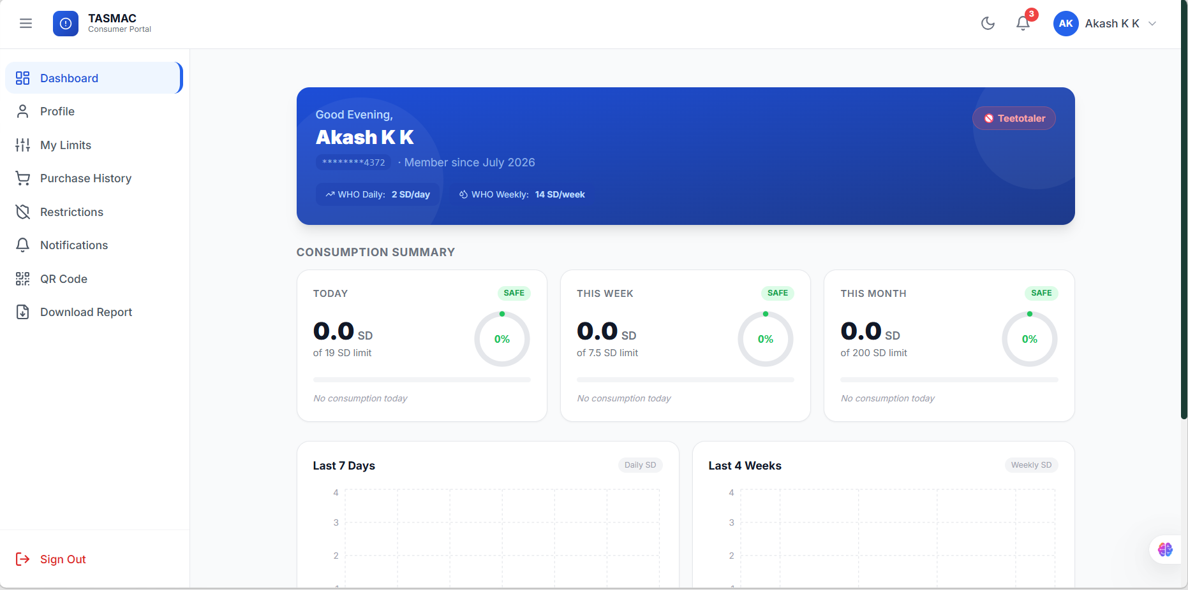
USER INTERFACE 3: Consumer Portal
A personalized dashboard for consumers to track purchases, manage limits, access QR identity, and receive alerts.

Slide 15
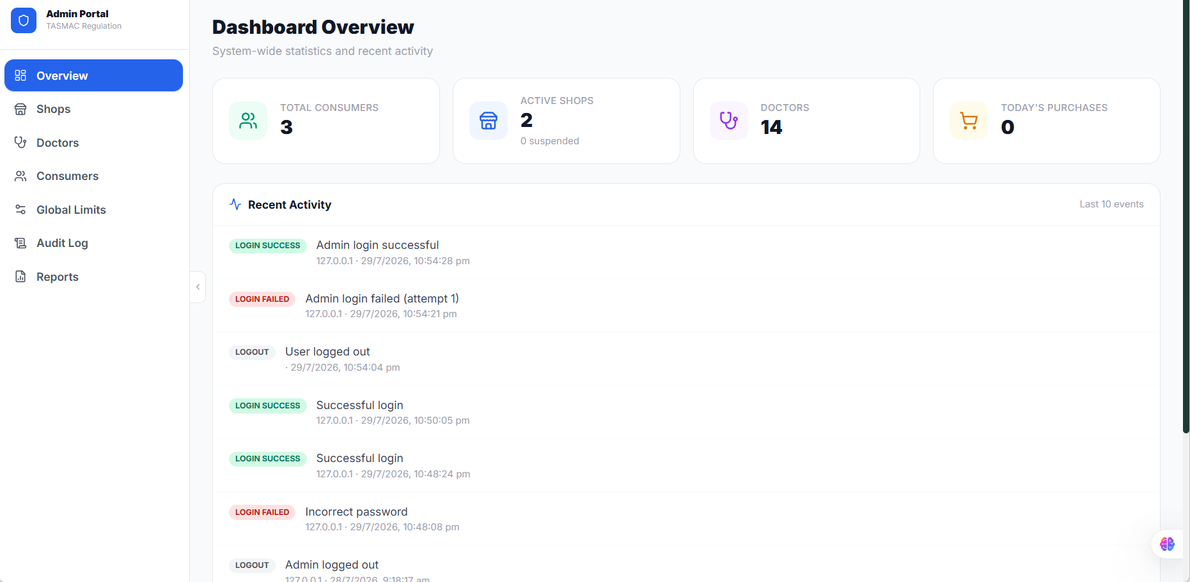
USER INTERFACE 4: Admin Portal
A centralized dashboard for managing users, shops, policies, reports, and monitoring the Smart TASMAC system.

Slide 16
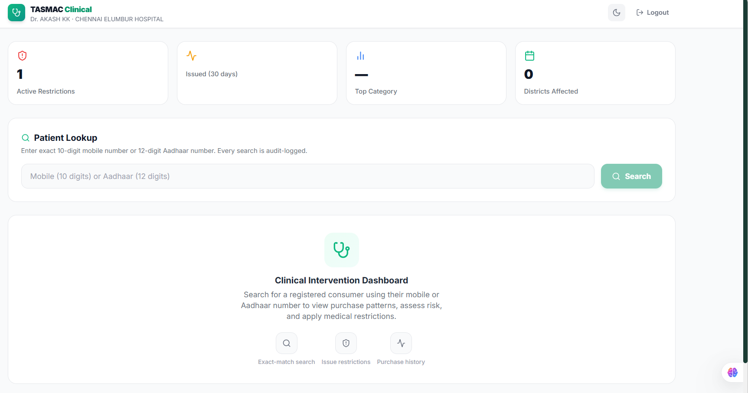
USER INTERFACE 5: Doctor Portal
A secure portal for doctors to monitor consumer health, review purchase history, and apply medical restrictions

Slide 17
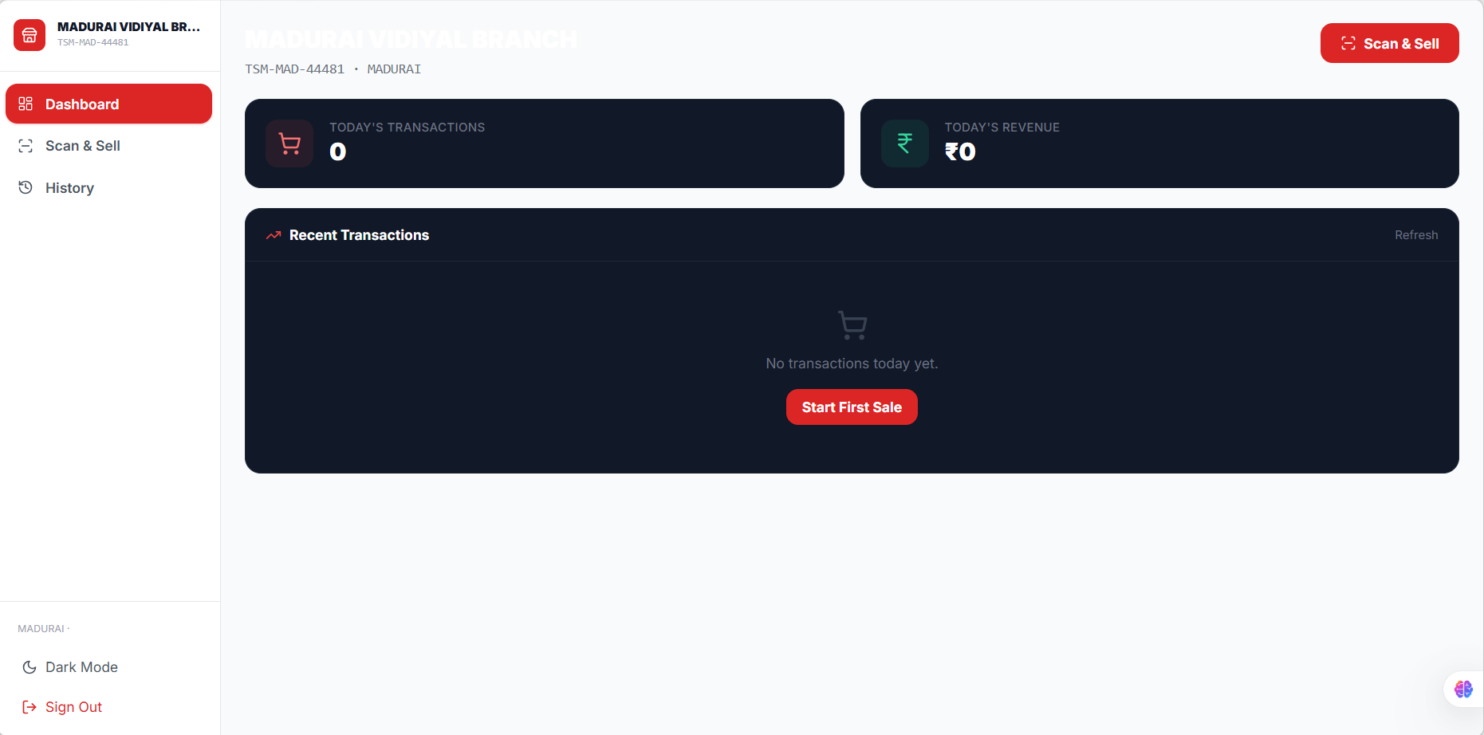
USER INTERFACE 6: Shop Portal
A secure portal for shop operators to verify consumers, process QR-based sales, and manage transaction records

Slide 18

Conculsion
Smart TASMAC is a secure, AI-enabled digital platform that promotes responsible alcohol consumption through identity verification, purchase regulation, healthcare integration, and real-time government monitoring.
Technology for Responsible Consumption • Transparency • Public Health • Good Governance

